Slide 1
CHAPTER IV: ADJUSTMENTS OR ADJUSTING PROCESS AND COMPLETING ACCOUNTING CYCLE
PRINCIPLES OF ACCOUNTING I

Slide 2
6
Adjusting The Accounts
Learning Objectives
Explain the accrual basis of accounting and the
reasons for adjusting entries.
1
2
Prepare adjusting entries for deferrals.
3
Prepare adjusting entries for accruals.
Describe the nature and purpose of an adjusted
trial balance.
4

Slide 3
LEARNING
OBJECTIVE
Explain the accrual basis of accounting
and the reasons for adjusting entries.
1
Accountants divide the economic life of a business into artificial time periods (Time Period Assumption).
. . . . .
Jan.
Feb.
Mar.
Apr.
Dec.
Generally a
month,
quarter, or
year.
Alternative Terminology
The time period assumption is also called the periodicity assumption.
LO 1

Slide 4
Fiscal and Calendar Years
Monthly and quarterly time periods are called interim periods.
Most large companies must prepare both quarterly and annual financial statements.
Fiscal Year = Accounting time period that is one year in length.
Calendar Year = January 1 to December 31.
LO 1

Slide 5
Fiscal and Calendar Years
Question
The time period assumption states that:
revenue should be recognized in the accounting period in which it is earned.
expenses should be matched with revenues.
the economic life of a business can be divided into artificial time periods.
the fiscal year should correspond with the calendar year.
LO 1

Slide 6
Accrual- versus Cash-Basis Accounting
Accrual-Basis Accounting
Transactions recorded in the periods in which the events occur.
Companies recognize revenues when they perform services (rather than when they receive cash).
Expenses are recognized when incurred (rather than when paid).
In accordance with generally accepted accounting principles (GAAP).
LO 1

Slide 7
Accrual- versus Cash-Basis Accounting
Cash-Basis Accounting
Revenues recognized when cash is received.
Expenses recognized when cash is paid.
Cash-basis accounting is not in accordance with generally accepted accounting principles (GAAP).
LO 1

Slide 8
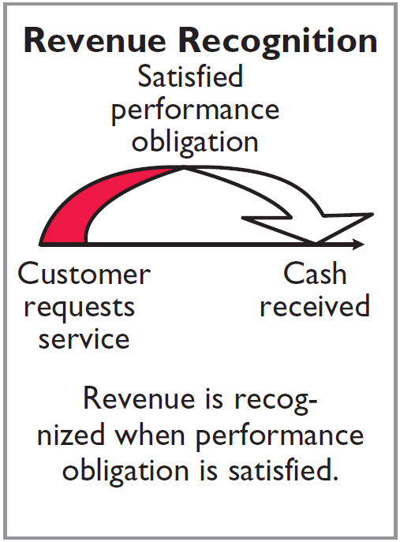
Recognizing Revenues and Expenses
REVENUE RECOGNITION PRINCIPLE
Recognize revenue in the accounting period in which the performance obligation is satisfied.
LO 1

Slide 9
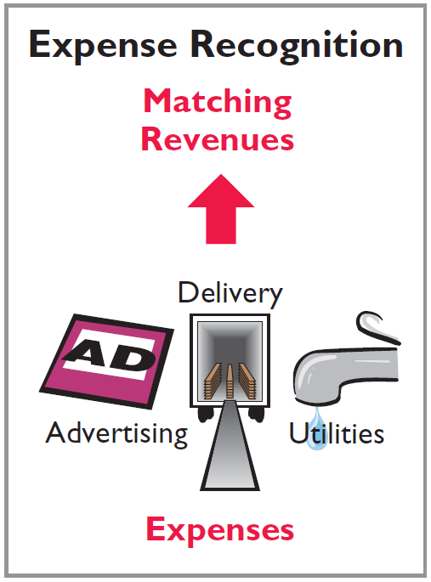
Recognizing Revenues and Expenses
EXPENSE RECOGNITION PRINCIPLE
Match expenses with revenues in the period when the company makes efforts that generate those revenues.
“Let the expenses follow the revenues.”
LO 1

Slide 10
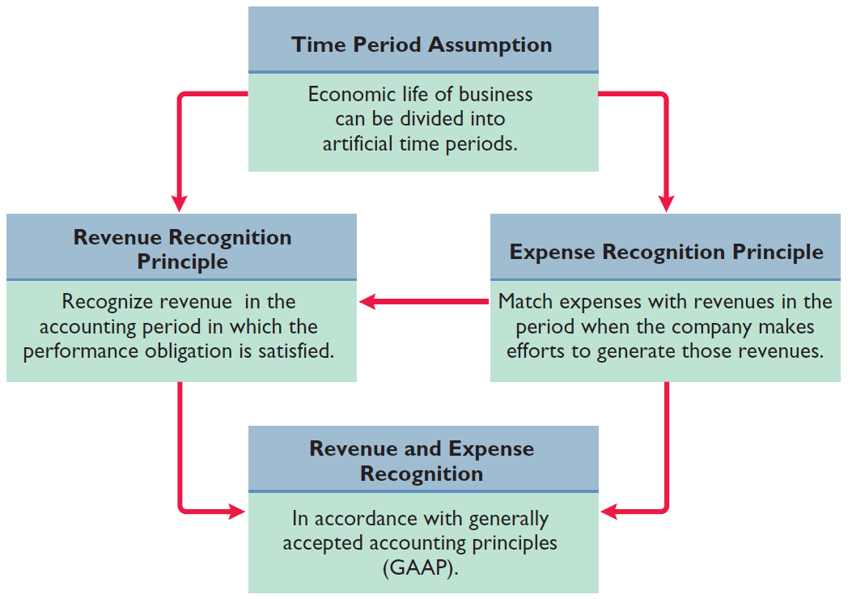
Illustration 3-1
GAAP relationships in revenue and expense recognition
LO 1

Slide 11
Recognizing Revenues and Expenses
Question
One of the following statements about the accrual basis of accounting is false? That statement is:
Events that change a company’s financial statements are recorded in the periods in which the events occur.
Revenue is recognized in the period in which the performance obligation is satisfied.
The accrual basis of accounting is in accord with generally accepted accounting principles.
Revenue is recorded only when cash is received, and expenses are recorded only when cash is paid.
LO 1

Slide 12
The Need for Adjusting Entries
Adjusting Entries
Ensure that the revenue recognition and expense recognition principles are followed.
Necessary because the trial balance may not contain up-to-date and complete data.
Required every time a company prepares financial statements.
Will include one income statement account and one balance sheet account.
LO 1

Slide 13
The Need for Adjusting Entries
Question
Adjusting entries are made to ensure that:
expenses are recognized in the period in which they are incurred.
revenues are recorded in the period in which services are performed.
balance sheet and income statement accounts have correct balances at the end of an accounting period.
all of the above.
LO 1

Slide 14
Types of Adjusting Entries
Illustration 3-2
Categories of adjusting entries
Deferrals
Accruals
1. Prepaid Expenses. Expenses paid in cash before they are used or consumed.
1. Accrued Revenues. Revenues for services performed but not yet received in cash or recorded.
2. Unearned Revenues.
Cash received before services are performed.
2. Accrued Expenses. Expenses incurred but not yet paid in cash or recorded.
LO 1

Slide 15
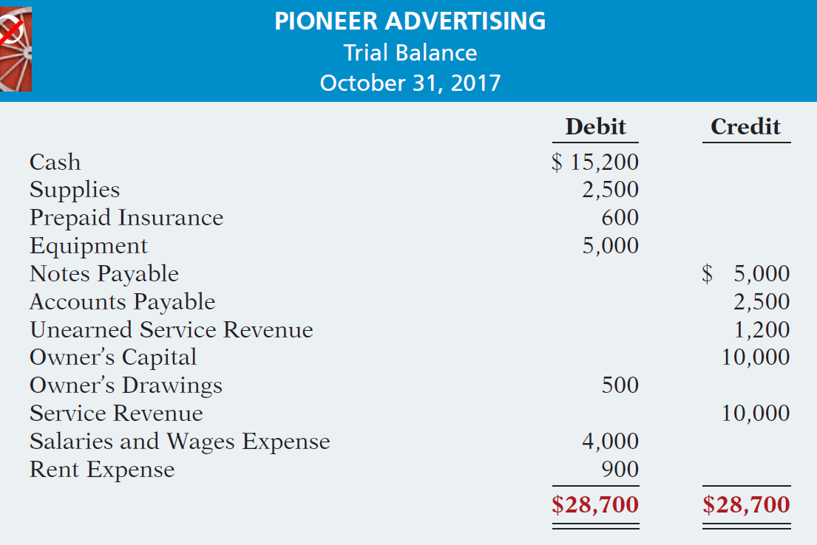
Types of Adjusting Entries
Trial Balance – Each account is analyzed to determine whether it is complete and up-to-date.
Illustration 3-3
LO 1

Slide 16

DO IT!
1
Timing Concepts
A list of concepts is provided in the left column below, with a description of the concept in the right column below. There are more descriptions provided than concepts. Match the description of the concept to the concept.
1. ___ Accrual-basis accounting.
2. ___ Calendar year.
3. ___ Time period assumption.
4. ___ Expense recognition principle.
f
Monthly and quarterly time periods.
Efforts (expenses) should be matched with results (revenues).
Accountants divide the economic life of a business into artificial time periods.
Companies record revenues when they receive cash and record expenses when they pay out cash.
An accounting time period that starts on January 1 and ends on December 31.
Companies record transactions in the period in which the events occur.
e
c
b
LO 1

Slide 17
LEARNING
OBJECTIVE
Prepare adjusting entries for deferrals.
2
Deferrals are expenses or revenues that are recognized at a date later than the point when cash was originally exchanged. There are two types:
Prepaid expenses
Unearned revenues
LO 2

Slide 18
Prepaid Expenses
Payment of cash, that is recorded as an asset to show the service or benefit the company will receive in the future.
Cash Payment
BEFORE
Expense Recorded
Prepayments often occur in regard to:
insurance
supplies
advertising
rent
equipment
buildings
LO 2

Slide 19
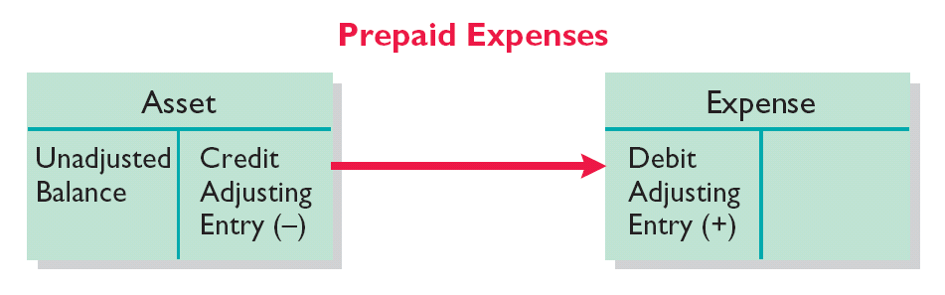
Prepaid Expenses
Expire either with the passage of time or through use.
Adjusting entry:
Increase (debit) to an expense account and
Decrease (credit) to an asset account.
Illustration 3-4
LO 2

Slide 20
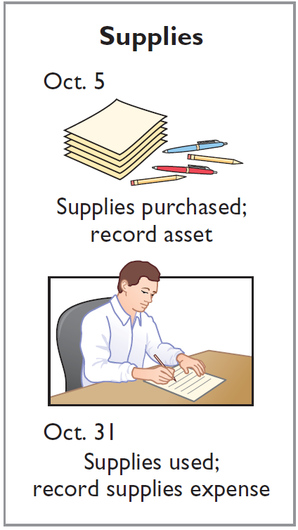
Supplies
Illustration: Pioneer Advertising purchased supplies costing $2,500 on October 5. Pioneer recorded the payment by increasing (debiting) the asset Supplies. This account shows a balance of $2,500 in the October 31 trial balance. An inventory count at the close of business on October 31 reveals that $1,000 of supplies are still on hand.
Oct. 31
Supplies Expense
1,500
Supplies
1,500
LO 2

Slide 21
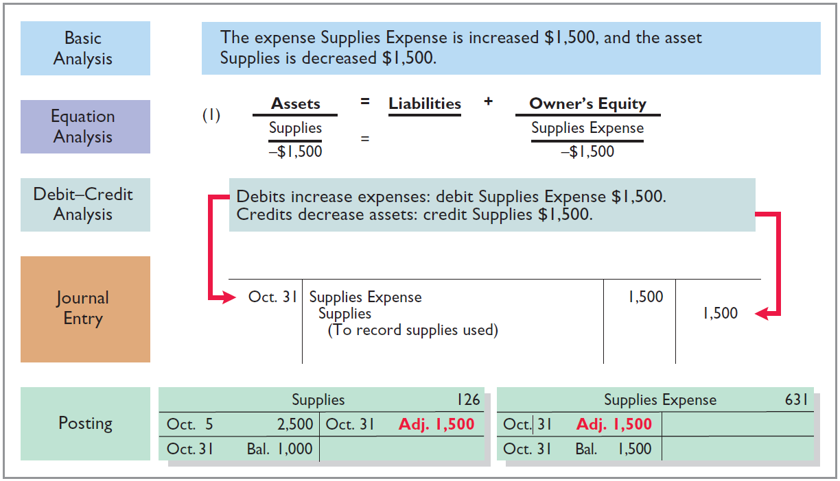
Supplies
Illustration 3-5
LO 2

Slide 22
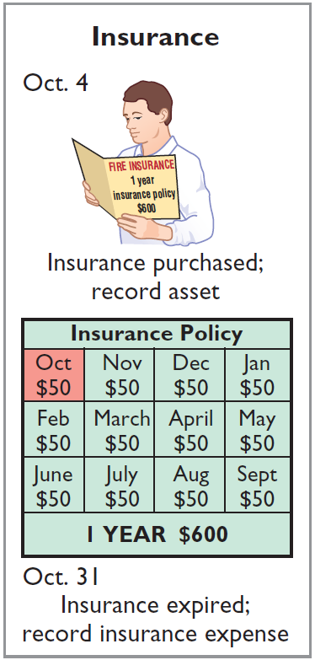
Insurance
Illustration: On October 4, Pioneer Advertising paid $600 for a one-year fire insurance policy. Coverage began on October 1. Pioneer recorded the payment by increasing (debiting) Prepaid Insurance. This account shows a balance of $600 in the October 31 trial balance. Insurance of $50 ($600 ÷ 12) expires each month.
Oct. 31
Insurance Expense
50
Prepaid Insurance
50
LO 2

Slide 23
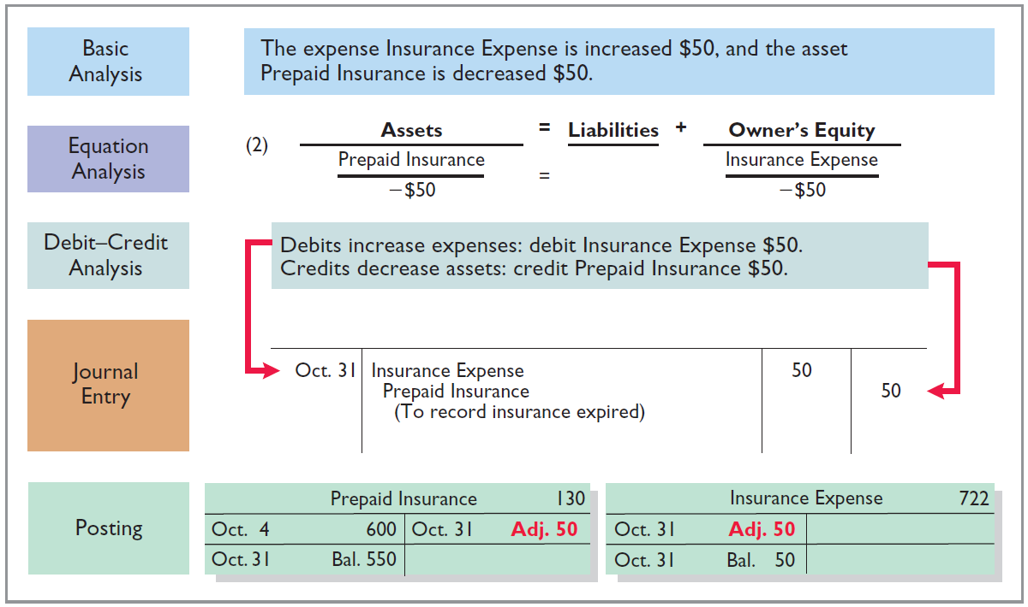
Insurance
Illustration 3-6
LO 2

Slide 24
Depreciation
Buildings, equipment, and motor vehicles (assets that provide service for many years) are recorded as assets, rather than an expense, on the date acquired.
Depreciation is the process of allocating the cost of an asset to expense over its useful life.
Depreciation does not attempt to report the actual change in the value of the asset.
Allocation concept, not a valuation concept.
LO 2

Slide 25
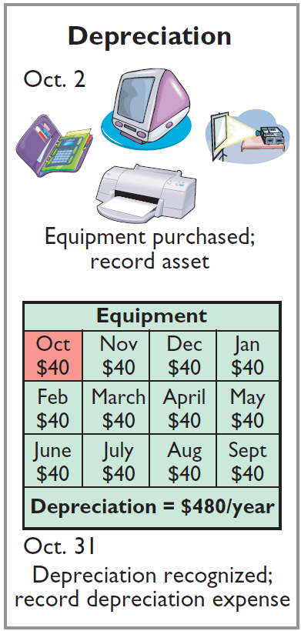
Depreciation
Illustration: For Pioneer Advertising, assume that depreciation on the equipment is $480 a year, or $40 per month.
Oct. 31
Depreciation expense
40
Accumulated depreciation
40
Accumulated Depreciation is called a contra asset account.
LO 2

Slide 26
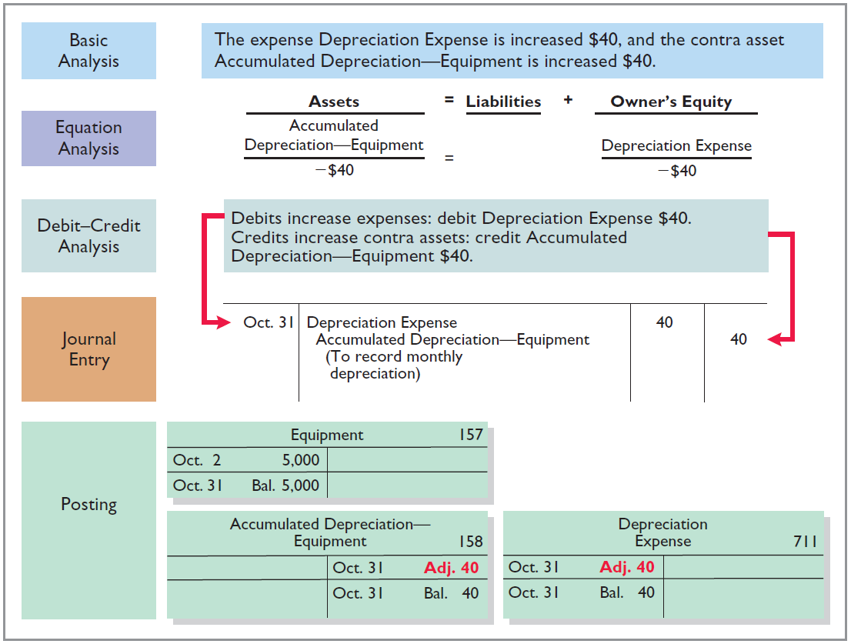
Illustration 3-7
LO 2

Slide 27
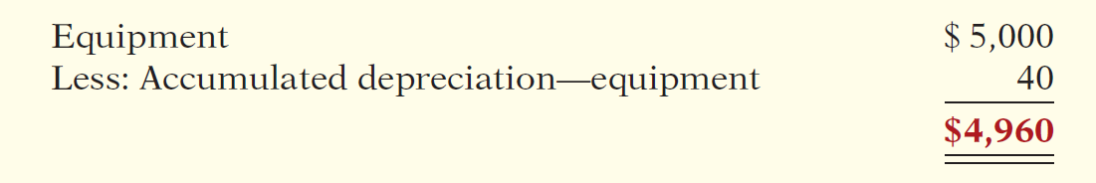
Depreciation
STATEMENT PRESENTATION
Accumulated Depreciation is a contra asset account (credit).
Offsets related asset account on the balance sheet.
Book value is the difference between the cost of any depreciable asset and its accumulated depreciation.
Illustration 3-8
LO 2

Slide 28
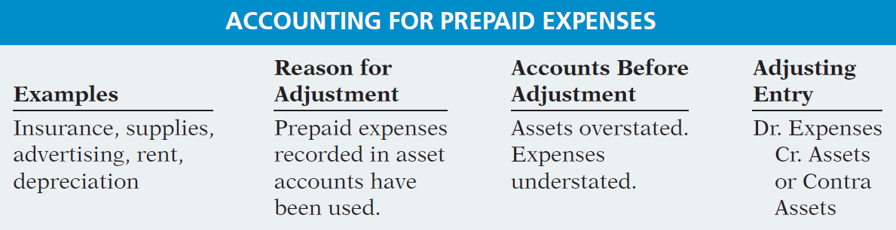
Prepaid Expenses
Summary of the accounting for prepaid expenses.
Illustration 3-9
Accounting for prepaid expenses
LO 2

Slide 29
Unearned Revenues
Receipt of cash that is recorded as a liability because the service has not been performed.
Cash Receipt
BEFORE
Revenue Recorded
Unearned revenues often occur in regard to:
Rent
Airline tickets
Magazine subscriptions
Customer deposits
LO 2

Slide 30
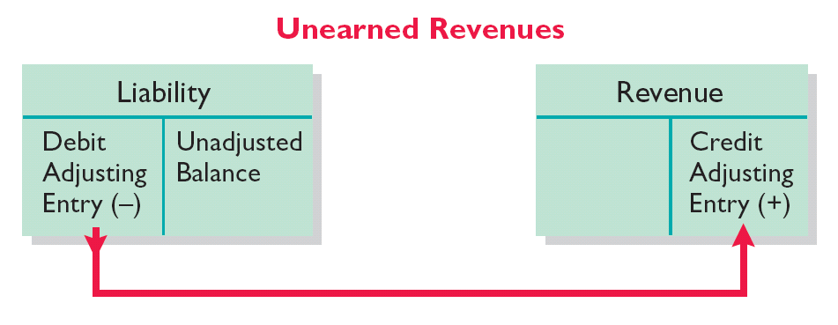
Unearned Revenues
Adjusting entry is made to record the revenue for services performed during the period and to show the liability that remains at the end of the period.
Results in a decrease (debit) to a liability account and an increase (credit) to a revenue account.
Illustration 3-10
LO 2

Slide 31
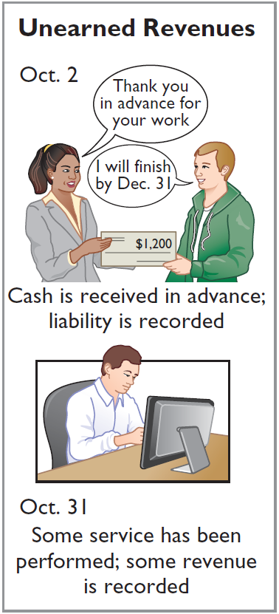
Unearned Revenues
Illustration: Pioneer Advertising received $1,200 on October 2 from R. Knox for advertising services expected to be completed by December 31. Unearned Service Revenue shows a balance of $1,200 in the October 31 trial balance. Analysis reveals that the company performed $400 of services in October.
Oct. 31
Unearned Service Revenue
400
Service Revenue
400
LO 2

Slide 32
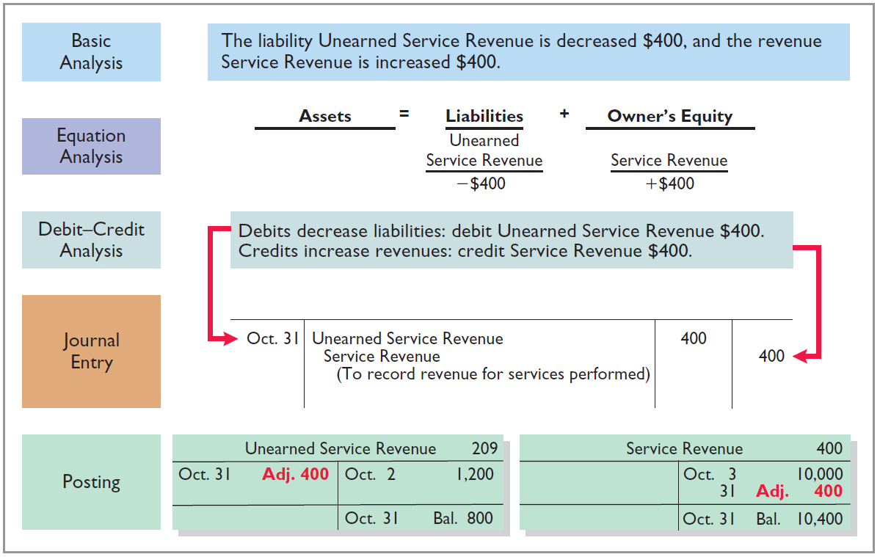
Unearned Revenues
Illustration 3-11
LO 2

Slide 33
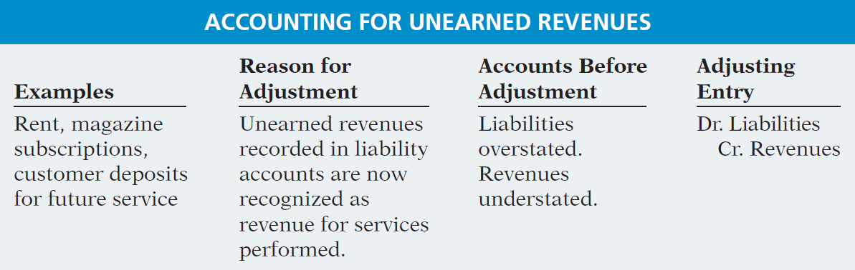
Unearned Revenues
Summary of the accounting for unearned revenues.
Illustration 3-12
LO 2

Slide 34
DO IT!
2
Adjusting Entries for Deferrals
The ledger of Hammond Company, on March 31, 2017, includes these selected accounts before adjusting entries are prepared.
Debit Credit
Prepaid Insurance $ 3,600
Supplies 2,800
Equipment 25,000
Accumulated Depreciation—Equipment $5,000
Unearned Service Revenue 9,200
An analysis of the accounts shows the following.
Insurance expires at the rate of $100 per month.
Supplies on hand total $800.
The equipment depreciates $200 a month.
During March, services were performed for one-half of the unearned service revenue.
Prepare the adjusting entries for the month of March.
LO 2

Slide 35
DO IT!
2
Adjusting Entries for Deferrals
The ledger of Hammond Company, on March 31, 2017, includes these selected accounts before adjusting entries are prepared.
Debit Credit
Prepaid Insurance $ 3,600
Supplies 2,800
Equipment 25,000
Accumulated Depreciation—Equipment $5,000
Unearned Service Revenue 9,200
Prepare the adjusting entries for the month of March.
Insurance expires at the rate of $100 per month.
Insurance Expense 100
Prepaid Insurance 100
LO 2

Slide 36
DO IT!
2
Adjusting Entries for Deferrals
The ledger of Hammond Company, on March 31, 2017, includes these selected accounts before adjusting entries are prepared.
Debit Credit
Prepaid Insurance $ 3,600
Supplies 2,800
Equipment 25,000
Accumulated Depreciation—Equipment $5,000
Unearned Service Revenue 9,200
Prepare the adjusting entries for the month of March.
Supplies on hand total $800.
Supplies Expense 2,000
Supplies 2,000
LO 2

Slide 37
DO IT!
2
Adjusting Entries for Deferrals
The ledger of Hammond Company, on March 31, 2017, includes these selected accounts before adjusting entries are prepared.
Debit Credit
Prepaid Insurance $ 3,600
Supplies 2,800
Equipment 25,000
Accumulated Depreciation—Equipment $5,000
Unearned Service Revenue 9,200
Prepare the adjusting entries for the month of March.
The equipment depreciates $200 a month.
Depreciation Expense 200
Accumulated Depreciation—Equipment 200
LO 2

Slide 38
DO IT!
2
Adjusting Entries for Deferrals
The ledger of Hammond Company, on March 31, 2017, includes these selected accounts before adjusting entries are prepared.
Debit Credit
Prepaid Insurance $ 3,600
Supplies 2,800
Equipment 25,000
Accumulated Depreciation—Equipment $5,000
Unearned Service Revenue 9,200
Prepare the adjusting entries for the month of March.
During March, services were performed for one-half of the unearned service revenue.
Unearned Service Revenue 4,600
Service Revenue 4,600
LO 2

Slide 39
LEARNING
OBJECTIVE
Prepare adjusting entries for accruals.
3
Accruals are made to record
Revenues for services performed but not yet recorded at the statement date.
Expenses incurred but not yet paid or recorded at the statement date.
LO 3

Slide 40
Accrued Revenues
Revenues for services performed but not yet received in cash or recorded.
Revenue Recorded
BEFORE
Cash Receipt
Accrued revenues often occur in regard to:
Rent
Interest
Services
LO 3

Slide 41
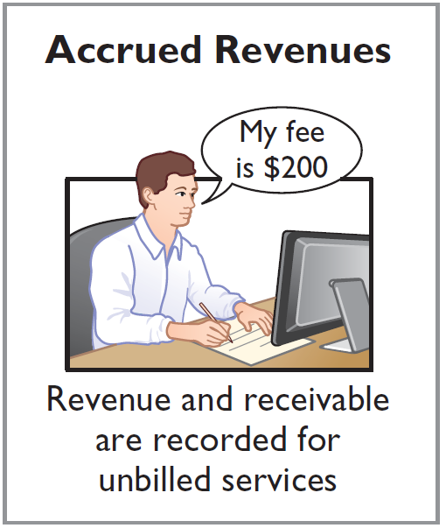
Accrued Revenues
Illustration: In October Pioneer Advertising performed services worth $200 that were not billed to clients on or before October 31.
Oct. 31
Accounts Receivable
200
Service Revenue
200
On November 10, Pioneer receives cash of $200 for the services performed.
Nov. 10
Cash
200
Accounts Receivable
200
LO 3

Slide 42
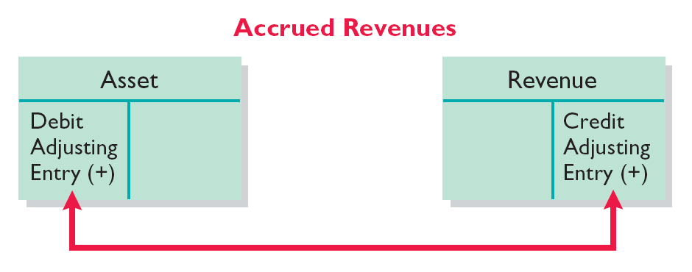
Accrued Revenues
Adjusting entry shows the receivable that exists and records the revenues for services performed.
Adjusting entry:
Increases (debits) an asset account and
Increases (credits) a revenue account.
Illustration 3-13
LO 3

Slide 43
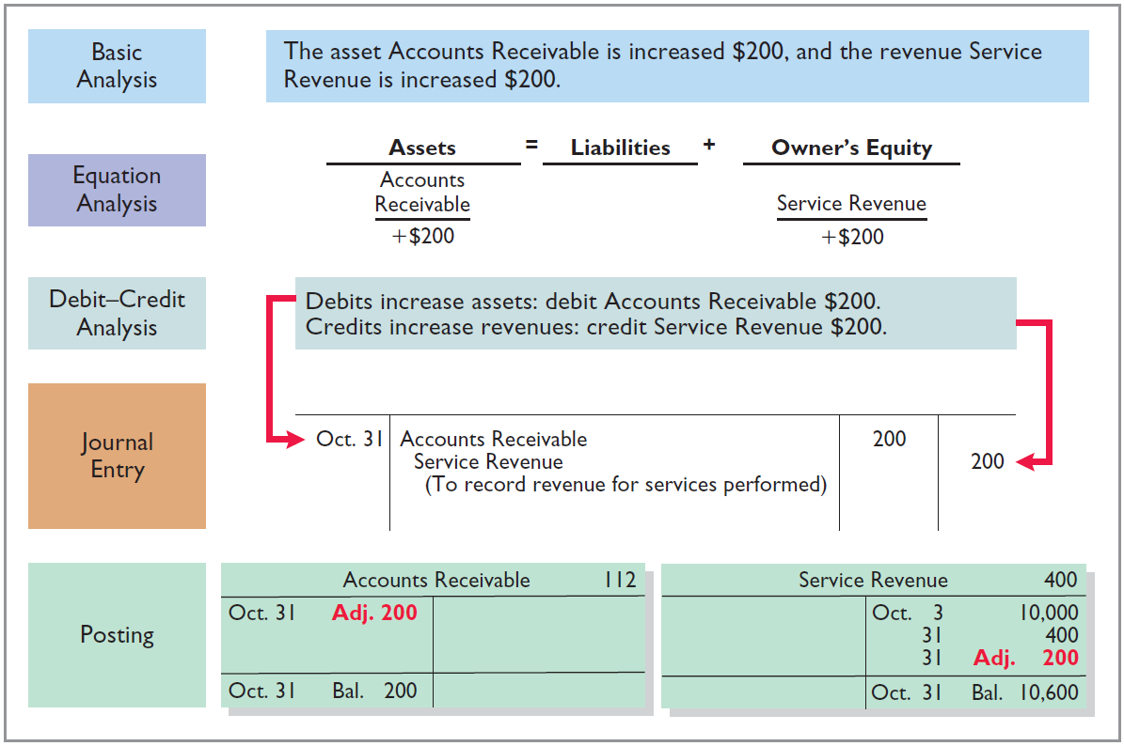
Accrued Revenues
Illustration 3-14
LO 3

Slide 44
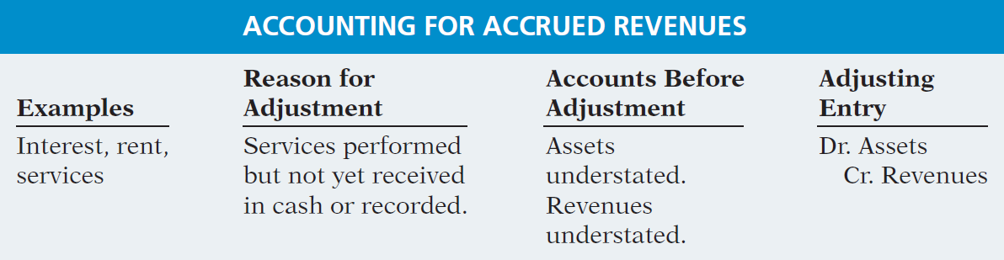
Accrued Revenues
Summary of the accounting for accrued revenues.
Illustration 3-15
LO 3

Slide 45
Accrued Expenses
Expenses incurred but not yet paid in cash or recorded.
Expense Recorded
BEFORE
Cash Payment
Accrued expenses often occur in regard to:
Rent
Interest
Taxes
Salaries
LO 3

Slide 46
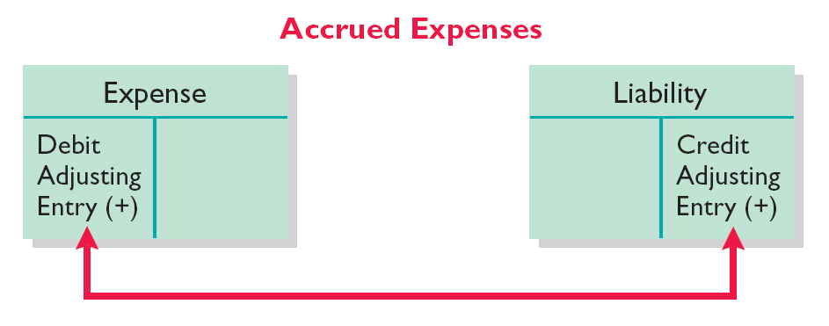
Accrued Expenses
Adjusting entry records the obligation and recognizes the expense.
Adjusting entry:
Increase (debit) an expense account and
Increase (credit) a liability account.
Illustration 3-16
LO 3

Slide 47
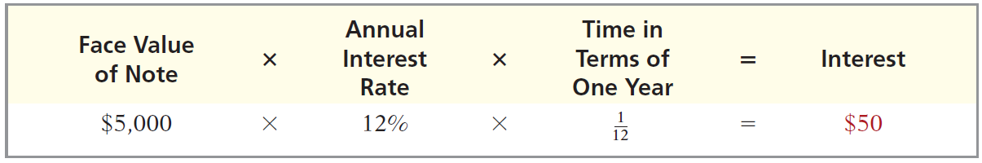
Accrued Expenses
ACCRUED INTEREST
Illustration: Pioneer Advertising signed a three-month note payable in the amount of $5,000 on October 1. The note requires Pioneer to pay interest at an annual rate of 12%.
Illustration 3-17
Oct. 31
Interest expense
50
Interest payable
50
LO 3

Slide 48
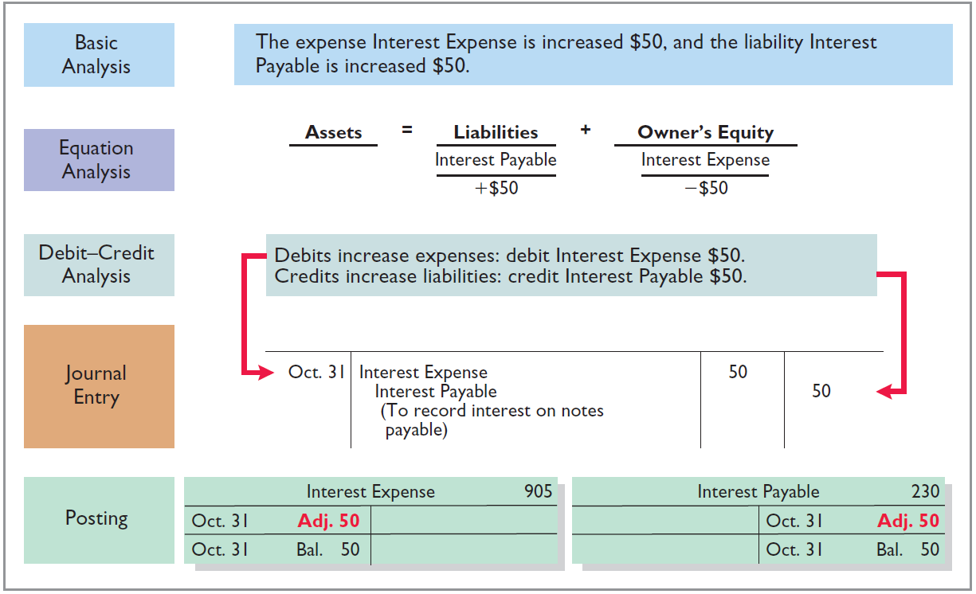
Accrued Expenses
Illustration 3-18
LO 3

Slide 49
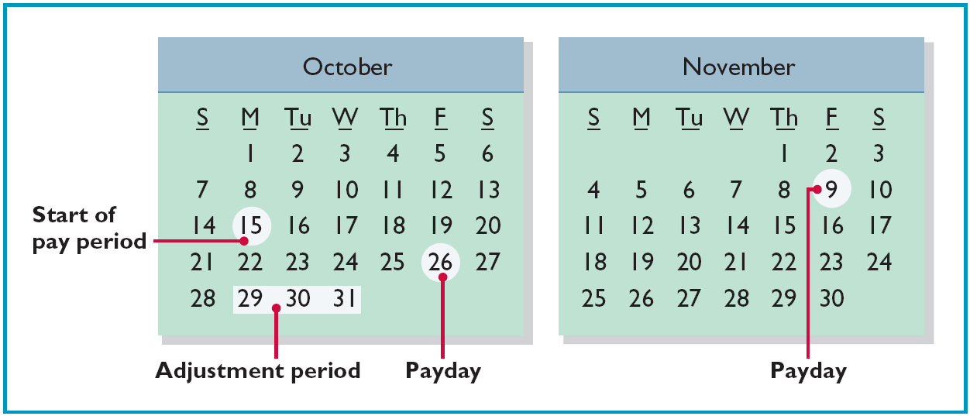
Accrued Expenses
ACCRUED INTEREST
Illustration: Pioneer Advertising paid salaries and wages on October 26; the next payment of salaries will not occur until November 9. The employees receive total salaries of $2,000 for a five-day work week, or $400 per day.
Illustration 3-19
LO 3

Slide 50
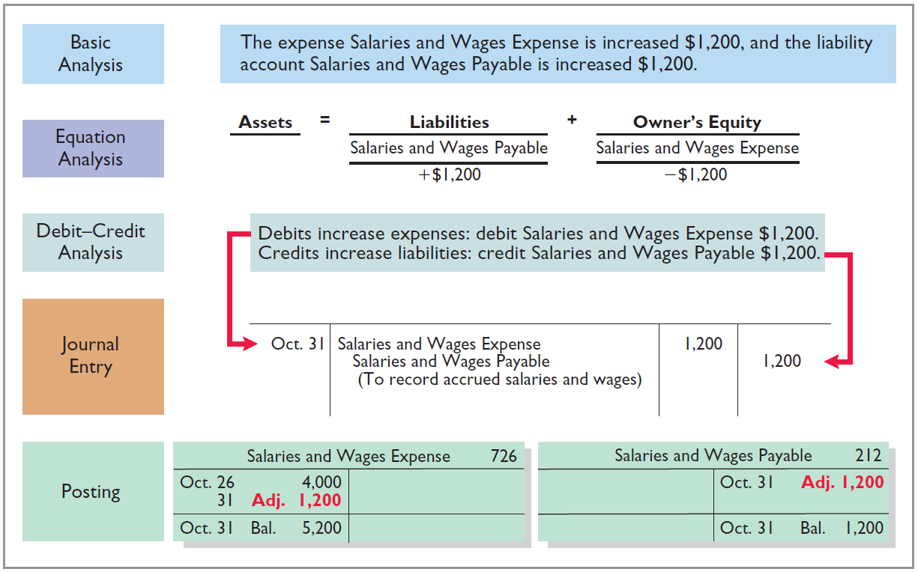
Accrued Expenses
Illustration 3-20
LO 3

Slide 51
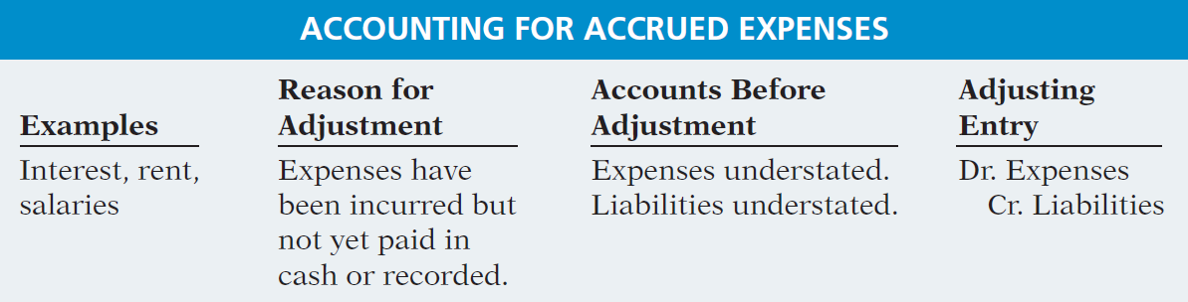
Accrued Expenses
Summary of the accounting for accrued expenses.
Illustration 3-21
LO 3

Slide 52
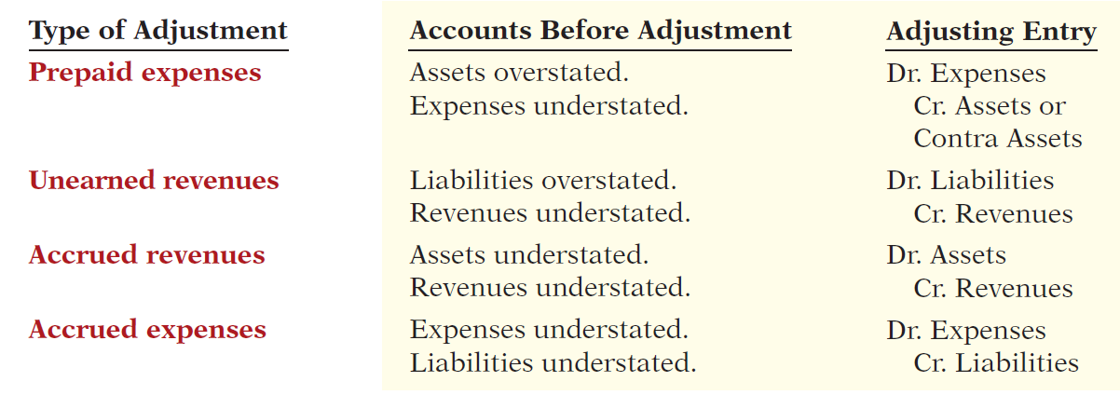
Summary of Basic Relationships
Illustration 3-22
LO 3

Slide 53
DO IT!
3
Adjusting Entries for Accruals
Micro Computer Services began operations on August 1, 2017. At the end of August 2017, management prepares monthly financial statements. The following information relates to August.
At August 31, the company owed its employees $800 in salaries and wages that will be paid on September 1.
On August 1, the company borrowed $30,000 from a local bank on a 15-year mortgage. The annual interest rate is 10%.
Revenue for services performed but unrecorded for August totaled $1,100.
Prepare the adjusting entries needed at August 31, 2017.
LO 3

Slide 54
DO IT!
3
Adjusting Entries for Accruals
Prepare the adjusting entries needed at August 31, 2017.
At August 31, the company owed its employees $800 in salaries and wages that will be paid on September 1.
On August 1, the company borrowed $30,000 from a local bank on a 15-year mortgage. The annual interest rate is 10%.
Revenue for services performed but unrecorded for August totaled $1,100.
Salaries and Wages Expense 800
Salaries and Wages Payable 800
Interest Expense 250
Interest Payable 250
Accounts Receivable 1,100
Service Revenue 1,100
LO 3

Slide 55
LEARNING
OBJECTIVE
Describe the nature and purpose of an adjusted trial balance.
4
Adjusted Trial Balance
Prepared after all adjusting entries are journalized and posted.
Purpose is to prove the equality of debit balances and credit balances in the ledger.
Is the primary basis for the preparation of financial statements.
LO 4

Slide 56
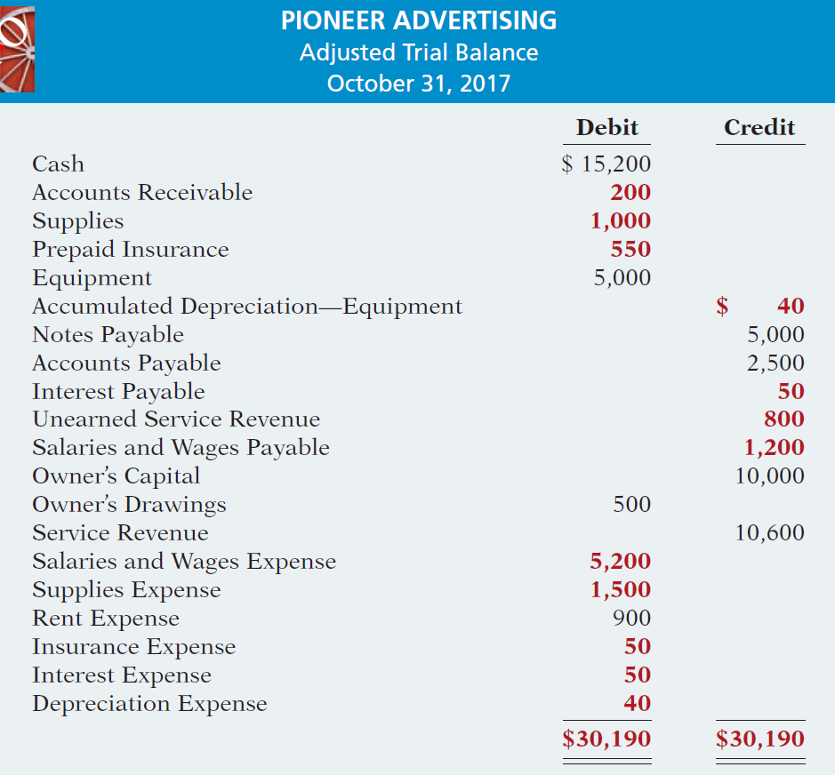

Illustration 3-25
LO 4

Slide 57
Adjusted Trial Balance
Question
Which of the following statements is incorrect concerning the adjusted trial balance?
An adjusted trial balance proves the equality of the total debit balances and the total credit balances in the ledger after all adjustments are made.
The adjusted trial balance provides the primary basis for the preparation of financial statements.
The adjusted trial balance lists the account balances segregated by assets and liabilities.
The adjusted trial balance is prepared after the adjusting entries have been journalized and posted.
LO 4

Slide 58
Preparing Financial Statements
Financial Statements are prepared directly from the Adjusted Trial Balance.
Income Statement
Owner’s Equity Statement
Balance Sheet
LO 4

Slide 59
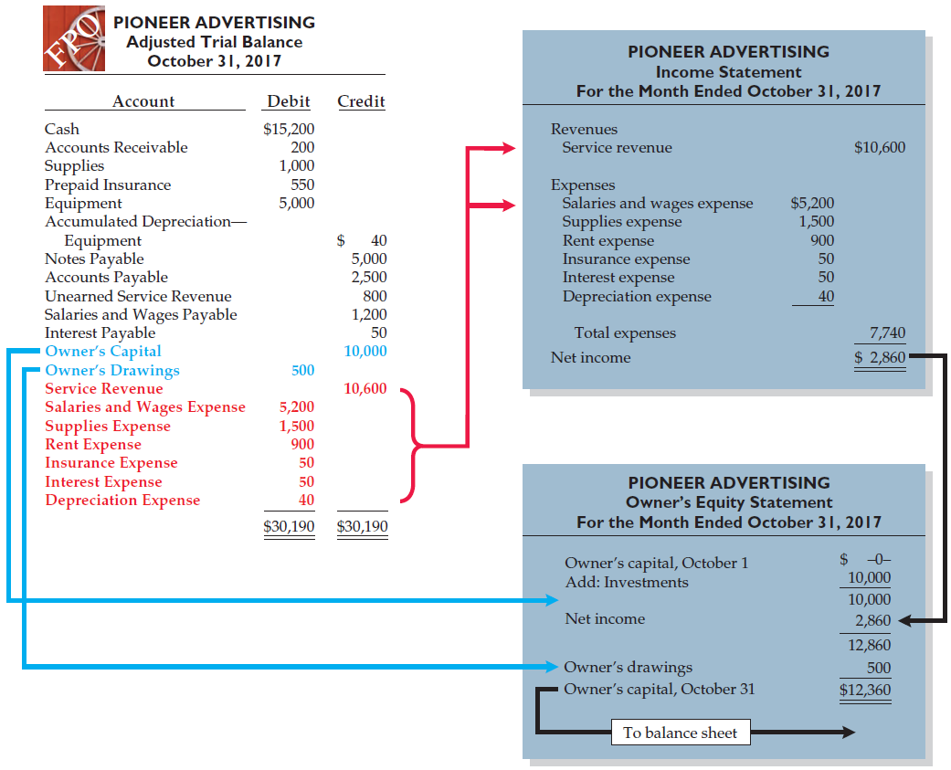
Illustration 3-26
Preparation of the income statement and owner’s equity statement from the adjusted trial balance

Slide 60
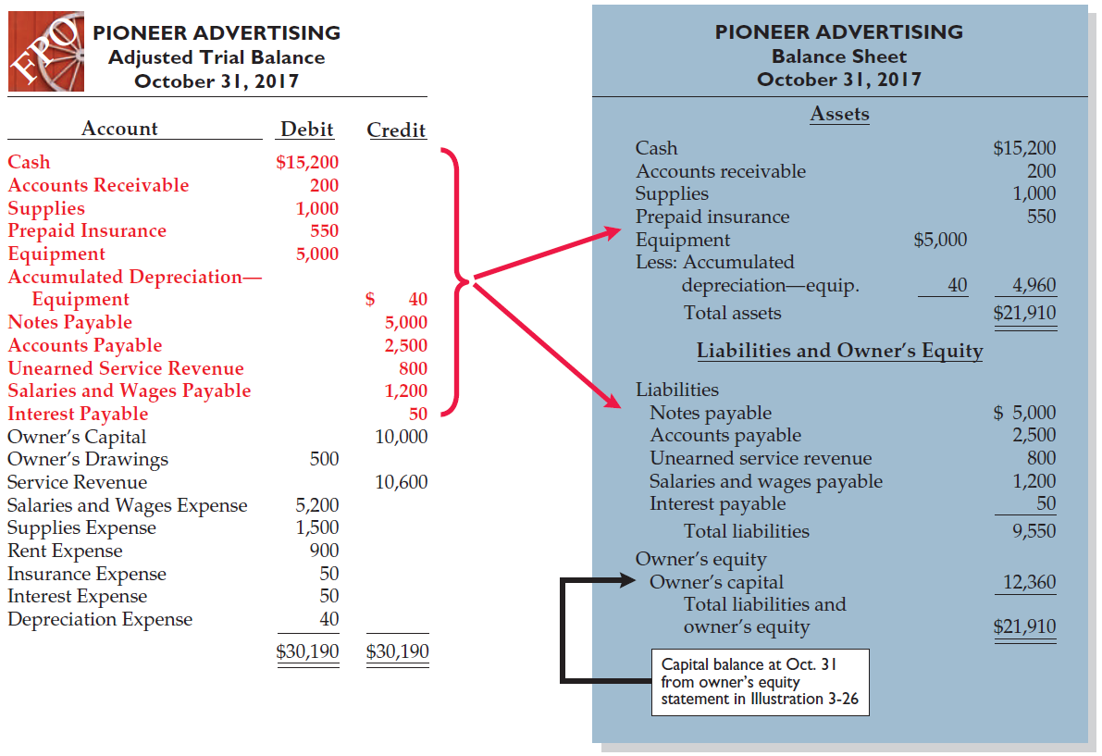
Illustration 3-27
Preparation of the balance sheet from the adjusted trial balance
LO 4

Slide 61
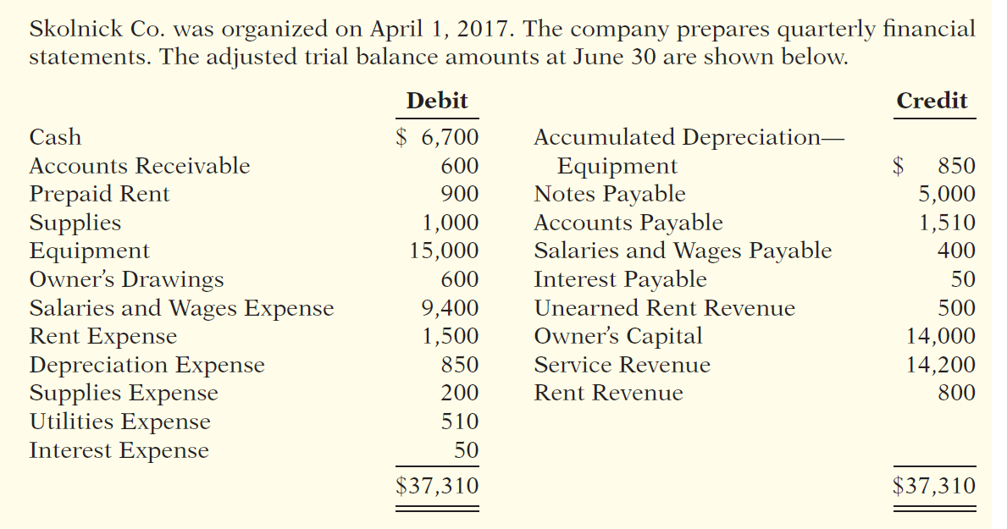
DO IT!
4
Trial Balance
(a) Determine the net income for the quarter April 1 to June 30.
(b) Determine the total assets and total liabilities at June 30, 2017, for Skolnick Co.
(c) Determine the amount of owner’s capital at June 30, 2017.
LO 4

Slide 62
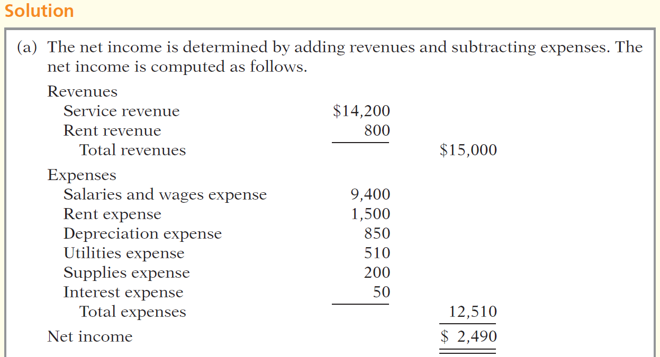
DO IT!
4
Trial Balance
LO 4

Slide 63
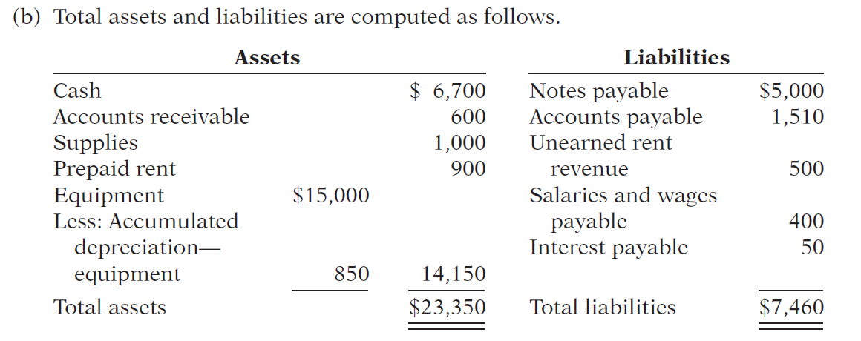
DO IT!
4
Trial Balance
LO 4

Slide 64
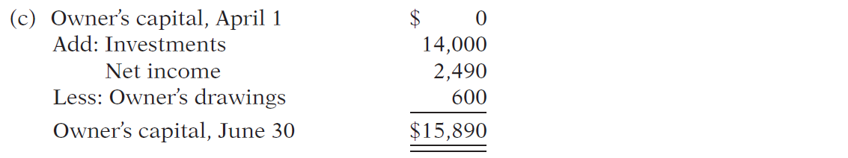
DO IT!
4
Trial Balance
LO 4

Slide 65
LEARNING
OBJECTIVE
APPENDIX 3A: Prepare adjusting entries for the alternative treatment of deferrals.
5
Alternate Treatment for Adjusting Entries
When a company prepays an expense, it debits that amount to an expense account.
When it receives payment for future services, it credits the amount to a revenue account.
LO 5

Slide 66
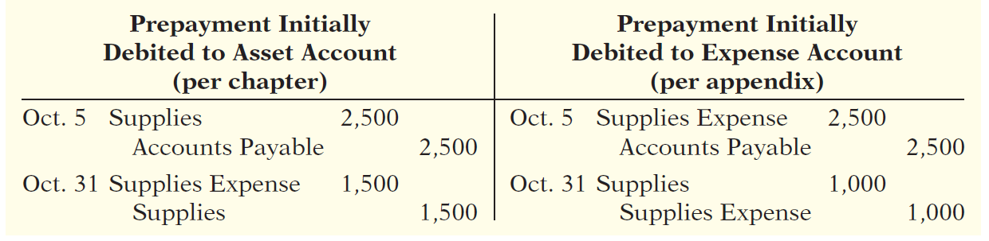
Prepaid Expenses
Company may choose to debit (increase) an expense account rather than an asset account. This alternative treatment is simply more convenient.
Illustration 3A-2
LO 5

Slide 67
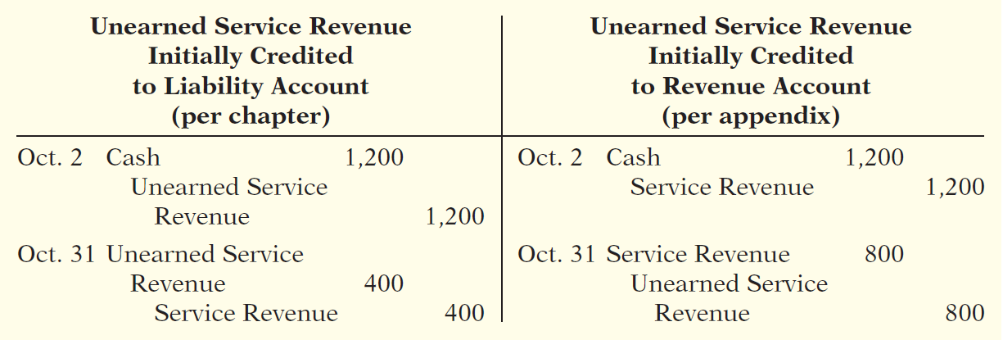
Unearned Revenues
Company may credit (increase) a revenue account when they receive cash for future services.
Illustration 3A-5
LO 5

Slide 68
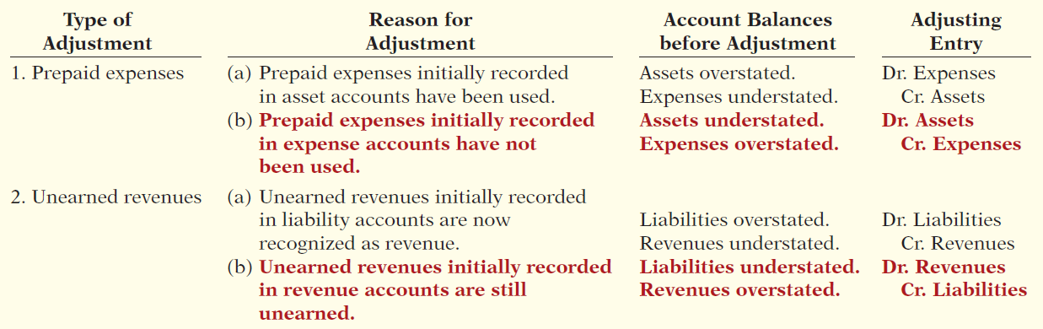
Summary of Additional Adjustments Relationships
Illustration 3A-7
LO 5

Slide 69
LEARNING
OBJECTIVE
APPENDIX 3B: Discuss financial reporting concepts.
6
Qualities of Useful Information
Two fundamental qualities, relevance and faithful representation.
Relevance
Make a difference in a business decision.
Provides information that has predictive value and confirmatory value.
Materiality is a company-specific aspect of relevance.
An item is material when its size makes it likely to influence the decision of an investor or creditor.
LO 6

Slide 70
Qualities of Useful Information
Two fundamental qualities, relevance and faithful representation.
Faithful Representation
Information accurately depicts what really happened.
Information must be
complete (nothing important has been omitted),
neutral (is not biased toward one position or another), and
free from error.
LO 6

Slide 71
Qualities of Useful Information
ENHANCING QUALITIES
Comparability results when different companies use the same accounting principles.
Information is verifiable if independent
observers, using the same methods, obtain similar results.
Information has the quality of understandability
if it is presented in a clear and concise fashion.
Consistency means that a company uses the same accounting
principles and methods from year to year.
For accounting information to have relevance, it must be timely.
LO 6

Slide 72
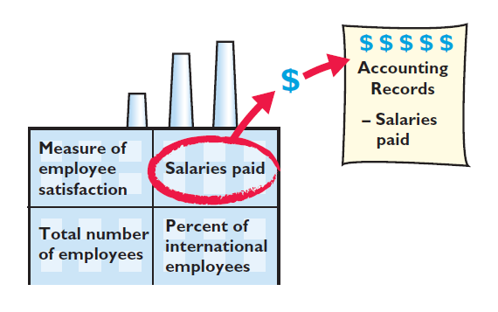
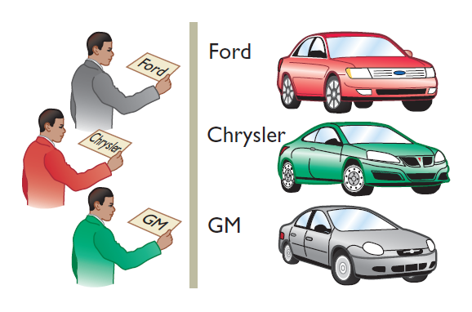
Assumptions in Financial Reporting
Illustration 3B-2
Monetary Unit
Economic Entity
Requires that only those things that can be expressed in money are included in the accounting records.
States that every economic entity can be separately identified and accounted for.
LO 6

Slide 73
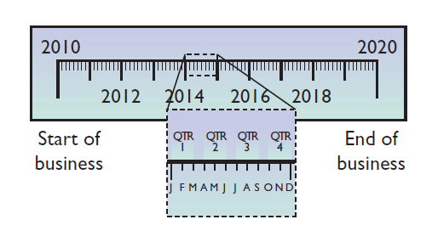

Assumptions in Financial Reporting
Illustration 3B-2
Time Period
Going Concern
States that the life of a business can be divided into artificial time periods.
The business will remain in operation for the foreseeable future.
LO 6

Slide 74
Principles of Financial Reporting
MEASUREMENT PRINCIPLES
Historical Cost
Fair Value
Or cost principle, dictates that companies record assets at their cost.
Indicates that assets and liabilities should be reported at fair value (the price received to sell an asset or settle
a liability).
LO 6

Slide 75
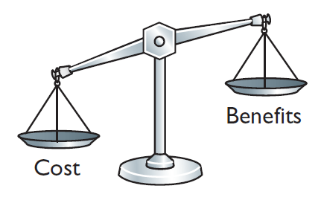
Cost Constraint
Cost Constraint
Accounting standard-setters weigh the cost that companies will incur to provide the information against the benefit that financial statement users will gain from having the information available.
LO 6

Slide 76

A Look at IFRS
LEARNING
OBJECTIVE
Compare the procedures for adjusting entries under GAAP and IFRS.
7
Key Points
Similarities
Companies applying IFRS also use accrual-basis accounting to ensure that they record transactions that change a company’s financial statements in the period in which events occur.
Similar to GAAP, cash-basis accounting is not in accordance with IFRS.
IFRS also divides the economic life of companies into artificial time periods. Under both GAAP and IFRS, this is referred to as the time period assumption.
LO 7

Slide 77

A Look at IFRS
Key Points
Similarities
The general revenue recognition principle required by GAAP that is used in this textbook is similar to that used under IFRS.
Revenue recognition fraud is a major issue in U.S. financial reporting. The same situation occurs in other countries, as evidenced by revenue recognition breakdowns at Dutch software company Baan NV, Japanese electronics giant NEC, and Dutch grocer Ahold NV.
LO 7

Slide 78
A Look at IFRS
Key Points
Differences
Under IFRS, revaluation (using fair value) of items such as land and buildings is permitted. IFRS allows depreciation based on revaluation of assets, which is not permitted under GAAP.
The terminology used for revenues and gains, and expenses and losses, differs somewhat between IFRS and GAAP. For example, income includes both revenues, which arise during the normal course of operating activities, and gains, which arise from activities outside of the normal sales of goods and services. The term income is not used this way under GAAP. Instead, under GAAP income refers to the net difference between revenues and expenses.
LO 7

Slide 79
A Look at IFRS
Key Points
Differences
Under IFRS, expenses include both those costs incurred in the normal course of operations as well as losses that are not part of normal operations. This is in contrast to GAAP, which defines each separately.
LO 7

Slide 80
A Look at IFRS
Looking into the Future
The IASB and FASB are completing a joint project on revenue recognition. The purpose of this project is to develop comprehensive guidance on when to recognize revenue. It is hoped that this approach will lead to more consistent accounting in this area. For more on this topic, see www.fasb.org/project/revenue_recognition.shtml.
LO 7

Slide 81
A Look at IFRS
IFRS Practice
IFRS:
uses accrual accounting.
uses cash-basis accounting.
allows revenue to be recognized when a customer makes an order.
requires that revenue not be recognized until cash is received.
LO 7

Slide 82
A Look at IFRS
IFRS Practice
Which of the following statements is false?
IFRS employs the periodicity assumption.
IFRS employs accrual accounting.
IFRS requires that revenues and costs must be capable of being measured reliably.
IFRS uses the cash basis of accounting.
LO 7

Slide 83
A Look at IFRS
IFRS Practice
As a result of the revenue recognition project being undertaken by the FASB and IASB:
revenue recognition places more emphasis on when the performance obligation is satisfied.
revenue recognition places more emphasis on when revenue is realized.
revenue recognition places more emphasis on when expenses are incurred.
revenue is no longer recorded unless cash has been received.
LO 7

Slide 84
COMPLETING THE ACCOUNTING CYCLE
Objectives
1. Prepare an accounting worksheet
2. Use the worksheet to prepare financial statements
3. Close the revenue, expense, and drawing accounts
4. Prepare the post-closing trial balance
5. Classify assets and liabilities as current or long-term
6. Ratios: current ratio and the debt ratio

Slide 85
Introduction
Each business or company should determine its ending period:
Example banks and many other private companies close the year end of December, 31 and start on January 01. While the Government of Rwanda starts the financial year on July 01, and ends the period on June 30, year +1. Others will start on 01-04 and will end on 31-03 year +1. Many educational institutions start on 1-10 and end on 30-09 year +1

Slide 86
Introduction cont’
In common each year is composed by 12 months. This period is the standard to make evaluation of the profit or the loss the business has made( Income statement), the change in capital ( Statement of owners equity), and the balance sheet. This work is called accounting cycle because it will be repeated every end of financial year of the business.

Slide 87
Accounting Cycle
Jan-Dec
Dec 31
Jan 1
Oct- Sep+1
Apr- Mar+1
Jul- June +1
Beginning period Ending period
January 01, Year____ December 31, Year___
April 01, Year____ March 31, Year____+1

Slide 88
Accounting worksheet
It is very simple to understand this accounting worksheet if really you still have a representation of Adjusted Trial Balance in your mind.
A sheet in excel helps to be sure that total Dr is equal to total credit in all columns of the sheet ( Trial Balance, Adjustment and Adjusted Trial Balance). Until now the accounting worksheet is not complete but it is based there.

Slide 89
Accounting Worksheet Cont’
Accounting worksheet is the existing sheet of Adjusted Trial plus two more main columns: Income Statement and Balance Sheet. The heading is also informing about the company’s name, Accounting Worksheet, and the date.
Accounts | Trial Balance |  | Adjustment |  | Adjusted Trial Balance |  | Income statement |  | Balance Sheet
 | Dr | Cr | Dr | Cr | Dr | Cr | Dr | Cr | Dr | Cr
Cash
Supplies
…….
Total

Slide 90
Accounting Worksheet Cont’
The Accounting worksheet repeats always the adjustment process that is why if you don’t understand well the previous chapter, it is meaningless to continue.
But this worksheet is a tool to indicate the income statement accounts separately from the accounts of Balance Sheet.

Slide 91
MYLA'S MOTORS
TRIAL BALANCE
November 30,2012
cash | 4,300
Account Receivable | 26,600
Supplies | 500
Prepaid Insurance | 1,700
Equipment | 53,500
Accumulated depreciation |  | 36,400
Account Payable |  | 13,400
Wages payable
Unearned Service Revenue |  | 8,000
Myla Capital |  | 19,700
Myla's drawing | 3,800
Service Revenue |  | 16,000
Depreciation Expense
Wages Expense | 1,600
Insurance Expense
Utilities Expense | 1,500
Total | 93,500 | 93,500

Slide 92
Data for adjustment
a. Depreciation on equipment, $1,100.
b. Accrued wage expense, $600.
c. Supplies on hand, $300.
d. Prepaid insurance expired during December, $200.
e. Unearned service revenue earned during December, $4,000.
f. Accrued service revenue, $800.

Slide 93
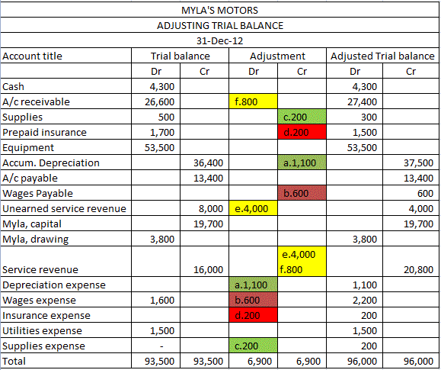
Adjusted TB

Slide 94
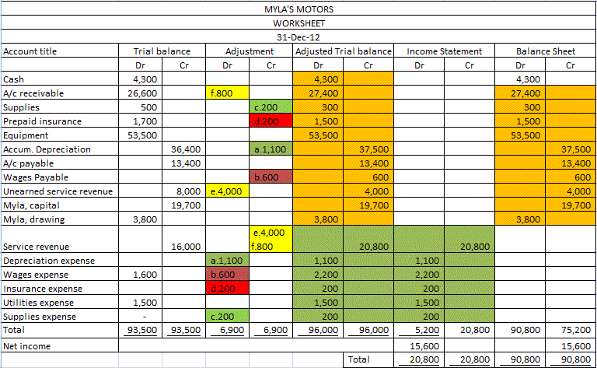

Slide 95
CONT’
The amounts of assets, liabilities and owner’s equity are transferred in the second new main column of Balance Sheet from adjusted TB
The amounts of revenue and expenses are transferred in the first new main column of Income Statement
Total debit and total credit in new columns show unbalanced figure (amount). It is reasonable because a new element net income is the focus of the business. Net Income = Service revenue- Total expense

Slide 96
Cont’
When the business has reached its goals the net income will be written under total expenses to balance the weak side of expenses and under credit side of Balance Sheet because it will increase the capital of the business.
When the business falls in loss, the result will be Net Loss instead of Net Income. Net loss = Total expenses – service revenue. The amount will be written under service revenue to balance the weak side, and under debit side of balance sheet, because it is going to decrease the capital of the business

Slide 97
Closing revenue, Expenses and drawings
At the end of year, after adjustments, revenues, expenses and owner withdrawals will be closed or will be zeroed. To zero an account is to balance it to zero. When it has a credit balance you debit it, and when it has a debit balance you credit it with the same amount.
There is a temporary account called Income Summary which is used to close revenues and expenses.

Slide 98
Closing revenue, Expenses and drawings
Accounts to be closed | Accounts used for closing
1. Service revenue | Income summary (Cr)
2. Expenses | Income summary (Dr)
3. Income summary | Owner’s Capital (Cr) or (Dr: for loss)
4. Owner withdrawal | Owner’s Capital (Dr)

Slide 99
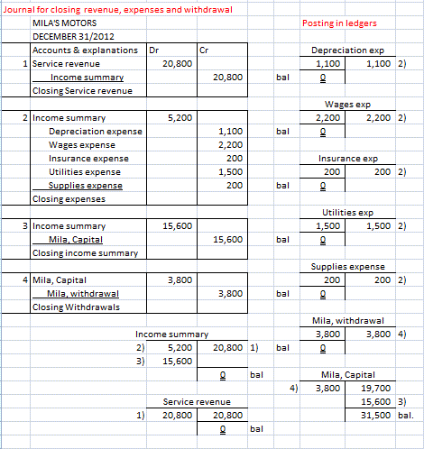
Closing revenue, Expenses and drawings: Journal and Ledgers

Slide 100
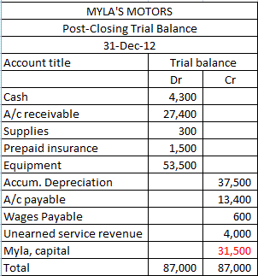
Preparing Post-Closing Trial Balance
The post-closing Trial Balance is the Trial balance without revenues, expenses and withdrawal after closing and modifying the capital.

Slide 101
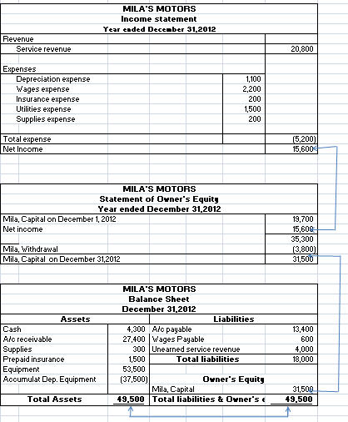
PREPARING INCOME STATEMENT, OWNER’S EQUITY STATEMENT AND BALANCE SHEET
1. INCOME
STATEMENT
2. STATEMENT
OF O-E
3.BALANCE
SHEET

Slide 102
Classifying Assets and Liabilities
1. Assets
Assets are what the business owns.
There are classified into two categories:
Current assets: “Current assets are items that will be used up in a year, like your notebook paper for this class or the change in your pocket” (Accounting 9th ed. P 212).
Fixed or Long-term assets: “Long-term assets are all the assets that will not be converted to cash within the business’s operating cycle” (Accounting 9th ed. P 212). Long-term assets can be used for more than a year, like your car or computer.
In the business of MlLA’S MOTORS,
current assets are: Cash, Accounts receivable, Supplies, and prepaid insurance
Long-term assets are: Equipment, and accumulated depreciation

Slide 103
Classifying Assets and Liabilities
2. Liabilities
Liabilities are what the business owes to outside people
Liabilities are categorized into two groups
Current liabilities: Current liabilities must be paid either with cash or with goods and services within one year, or within the entity’s operating cycle if the cycle is longer than a year.
Long term liabilities: All liabilities that do not need to be paid within the entity’s operating cycle are classified as long-term liabilities.
In MILA’S MOTORS Business, there are only current liabilities, those are:
accounts payable,
wages payable, and
unearned service revenue

Slide 104
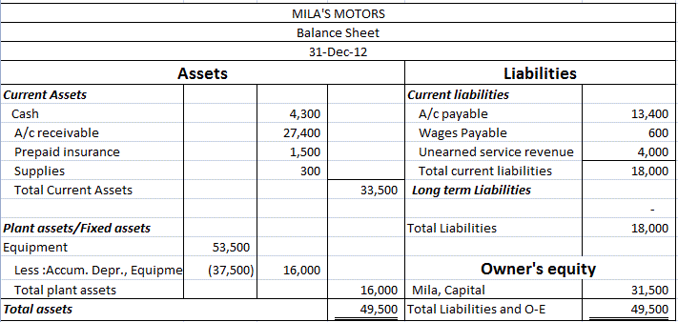
Balance Sheet: Account Form

Slide 105
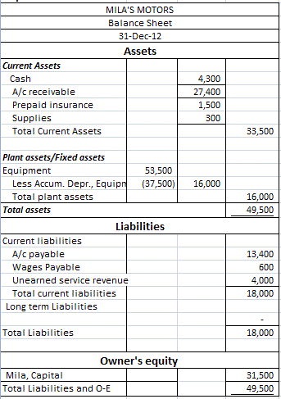
Balance Sheet: Report Form

Slide 106
Accounting Ratios
Accounting ratios help decision makers to unsure the standing of their businesses. They reveal the power and capacity of a business to pay its debts
From many ratios, at this level let us talk about 2 ratios: Current Ratio and Debt Ratio
1. Current Ratio
The current ratio measures a company’s ability to pay its current liabilities with its
current assets. This ratio is computed as follows:
Current ratio = TCA/TCL

Slide 107
Accounting Ratios
A rule of Thumb:
Current ratio (CR) = 1.5 and above is perfect
C R > 1.0 <1.5 is acceptable
CR< 1.0 is very bad and risky
2. Debt ratio (DR)
The debt ratio measures an organization’s overall ability to pay its total liabilities
(debt). The debt ratio is computed as follows:

Slide 108
Accounting Ratios
Debt ratio= (TL/TA)*100
A rule of Thumb
A Debt Ratio (DR) of 60% and below is perfect
DR >60% <80% is acceptable
DR > 80% is very bad and risky

Slide 109
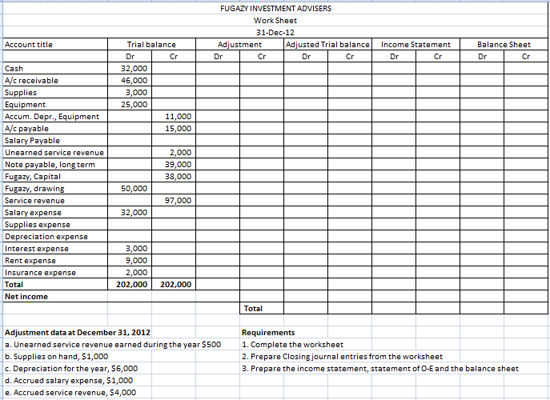
ASSIGNMENT ON WORKSHEET

